Slide 1
DATA STORYTELLING
BY
AUWALU HALADU ALIYU
FE/23/50048300

Slide 2
INTRODUCTION
To better understanding the spending habits of the students across various demographic group and academic background.

Slide 3
AIMS AND OBJECTIVES
My aims and objectives is to know the students spending habit, financial literacy, budgeting strategy and payment preferences.

Slide 4
METHODOLOGY
The dataset to be used for this analysis was generated from outline educational data collection site and research analysis site.

Slide 5
KEY QUESTIONS
Which depertment has the highest monthly spending?
Which method of payment used most in a school?
Which aspect of life does students spend most?
Among gender, who spend more in entertainment and technology?

Slide 6
FINDING AND INSIGHT

Slide 7
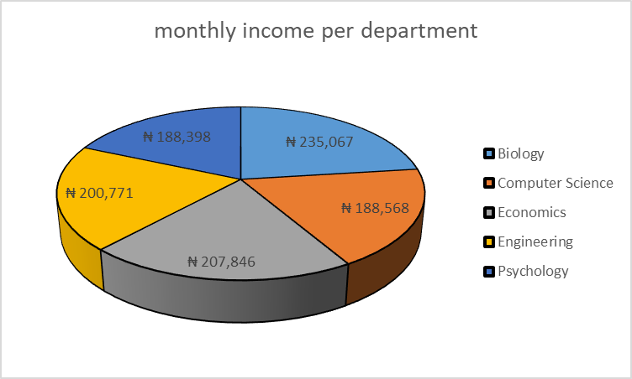
Which department has the highest monthly spending?
From the data collected, I have dive into the analysis which enable me to bring the insight as department of biology has the highest amount income monthly.

Slide 8
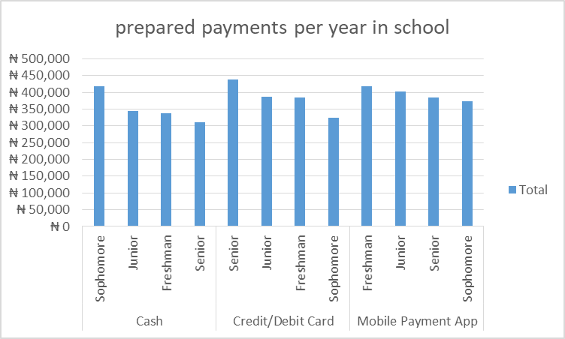
Which method of payment used most in a school?
dive in to the ocean of analysis, I have analyzed that base of the data gathered we have classify the method of spending in three category as follows:
1-cash
Sophomore has the highest money spend per year.
2-credit/debid
Senior has the highest money spend per year.
3-mobile app.
Freshman has the highest money spend per year.

Slide 9
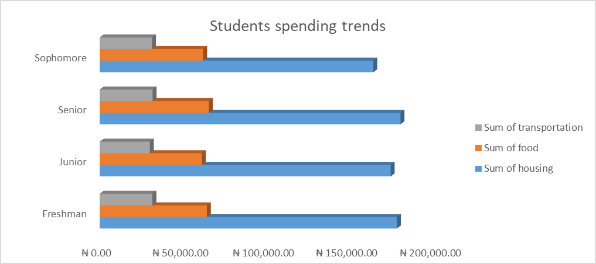
Which aspect of life does students spend most?
By continue going deep in to analysis, I focus on the area where most of the student spend their money in the school activities throughout the year, throughout the methods we conclude that three items have been identified:
1- sum of transportation
2-sum of food
3-sum of housing

Slide 10
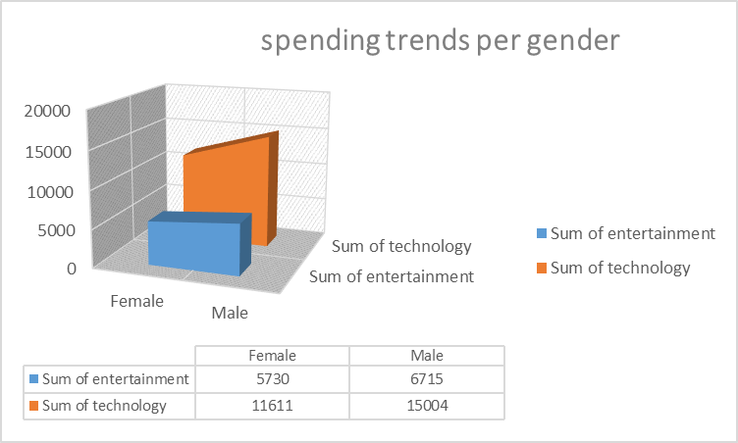
Among gender, who spend more in entertainment and technology?
By the analysis concluded base on gender male spend their money most on both entertainment and technology

Slide 11
RECOMMENDATION
Base on the analysis conclusion male students spend their money most in all the series of activities throughout the year.

